Slide 1
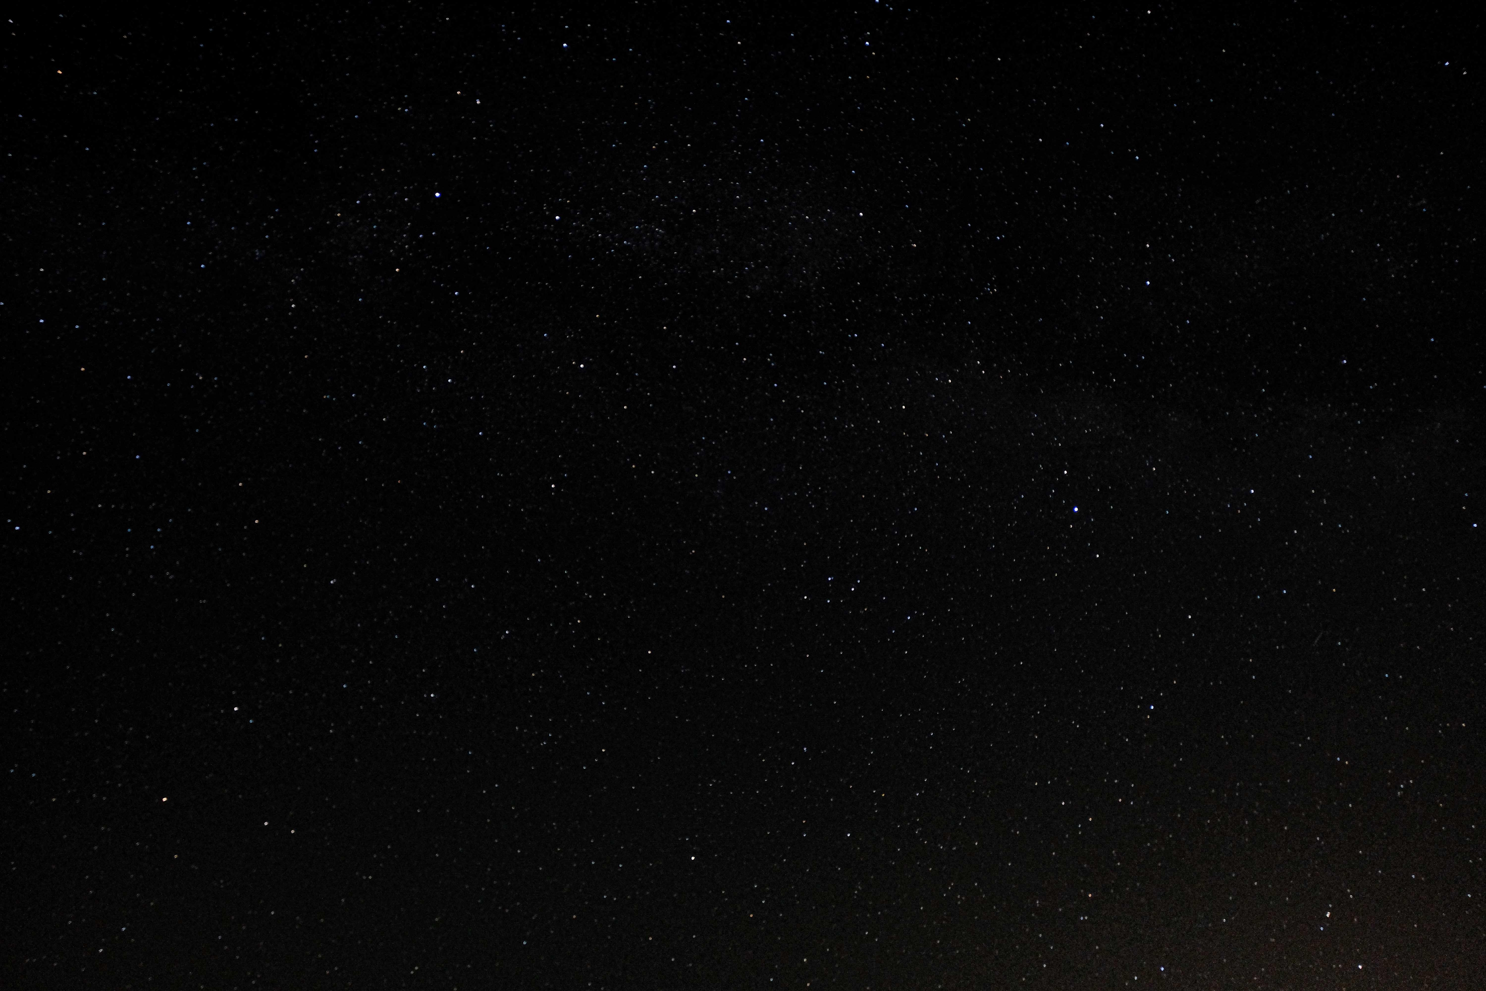

Slide 2
EPISODE IIX
A Final Project
It is a period of civil war. Rebel students have won their first victory against the evil Large Language Empire.
During battle, rebel spies managed to steal the Empire’s secret trivia questions.
Rebel forces have managed to create a chat bot that answers Star Wars questions with the assistance of Yoda…

Slide 3
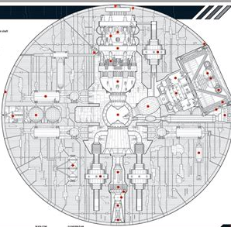
Stolen questions
Total of 609 questions scraped from
https://randomtrivia.co/star-wars-trivia/
https://www.watercoolertrivia.com/trivia-questions/star-wars-trivia
https://pastquestionsandanswers.com/star-wars-trivia-questions/

Slide 4
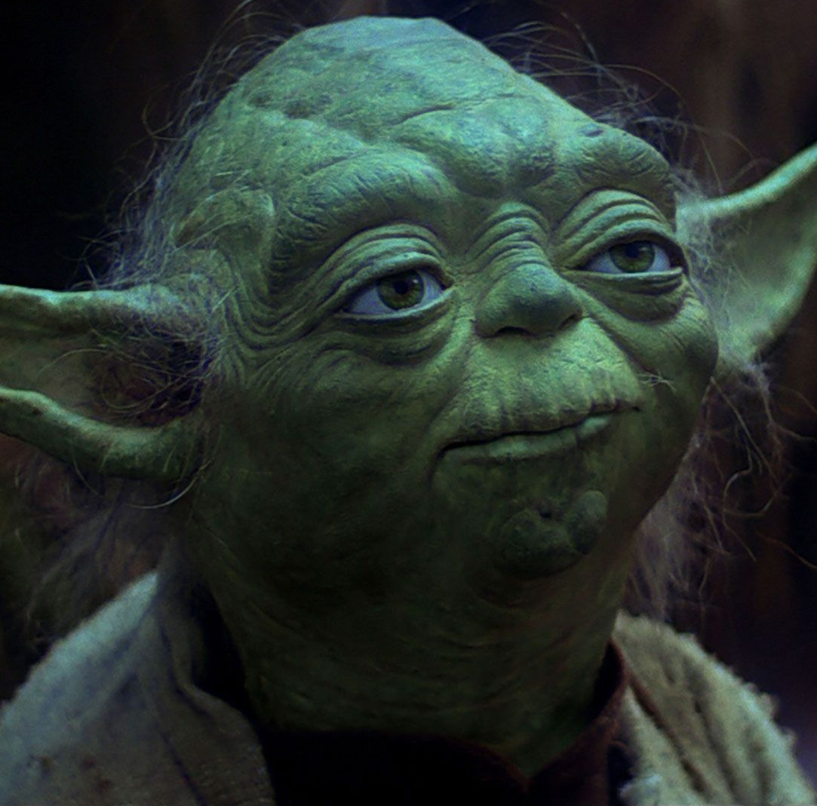
Yoda chatbot
Model
Meta-Llama-3.1-8B-Instruct-bnb-4bit
Did some fine tuning on a small dataset to have it talk Yoda.
Converted it to GGUF to use with Ollama.
Quantized with q4_k_m
Notes:
First tried converting a model via.

Slide 5
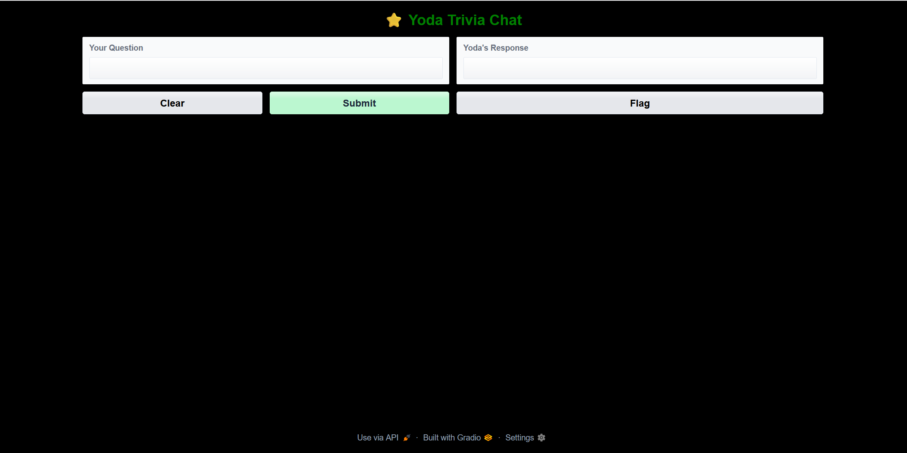
Gradio interface
python3 app.py

Slide 6
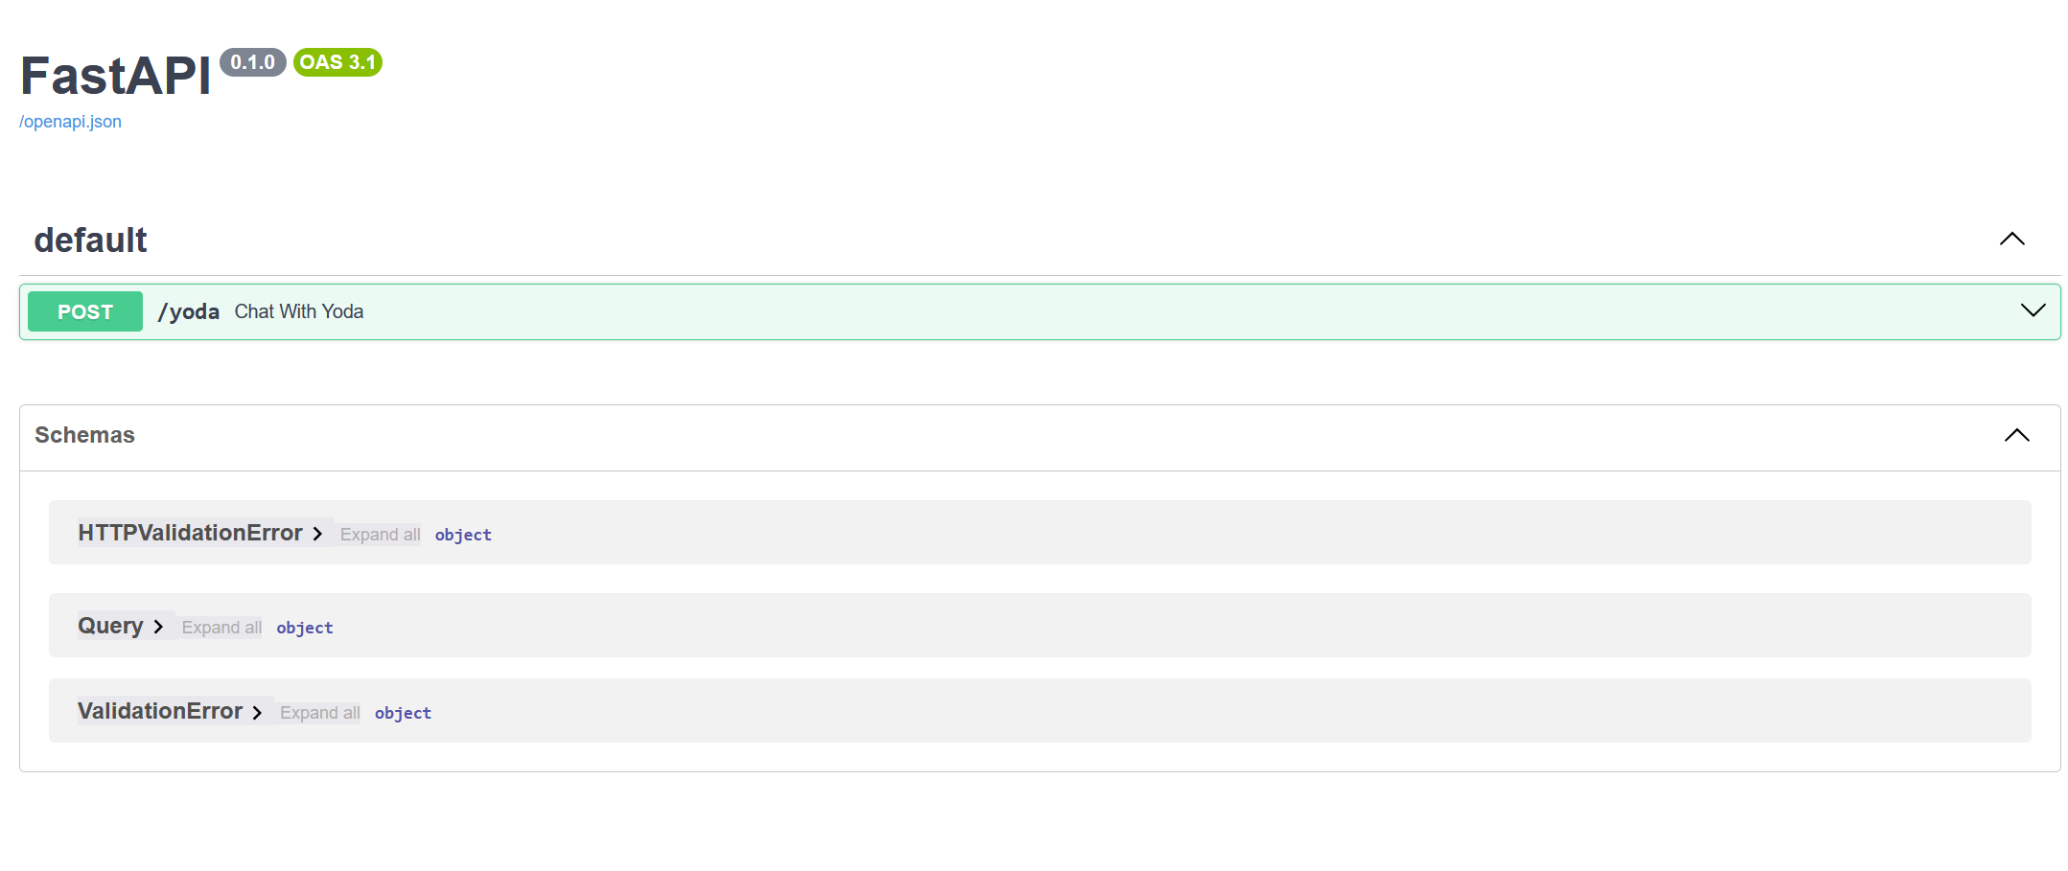
API –using FASTAPI
Runs well with FastAPI locally. Needs work using ngrok
uvicorn api_app:app --reload --host 0.0.0.0 --port 8000

Slide 7
Total setup
1. User Query: User submits a natural language question through the Gradio app or API.
3. Retrieval (FAISS):2. Embedding: The question is embedded into a dense vector using a SentenceTransformer model (all-MINILLM-V6-L2) The embedding is compared against a vector database (FAISS) to retrieve top relevant trivia documents.
4. Prompt Construction: The system builds a prompt by combining:
Retrieved trivia context
User’s original question
Yoda-style system instructions
5. Generation (LLM via Ollama): The constructed prompt is sent to a fine-tuned Yoda LLM (running locally via Ollama), which generates a
response in Yoda’s speech style.
6. Response: The Yoda-styled answer is returned to the user through the Gradio chat interface or API response.

Slide 8
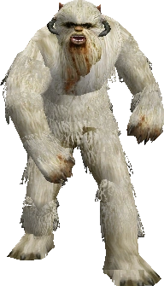
Example
What is the name of the creature that capture Luke on the ice planet Hoth?
"A trap, they set. Wampa's lair, young Luke falls into. Savage and fierce, a creature it is."

Slide 9
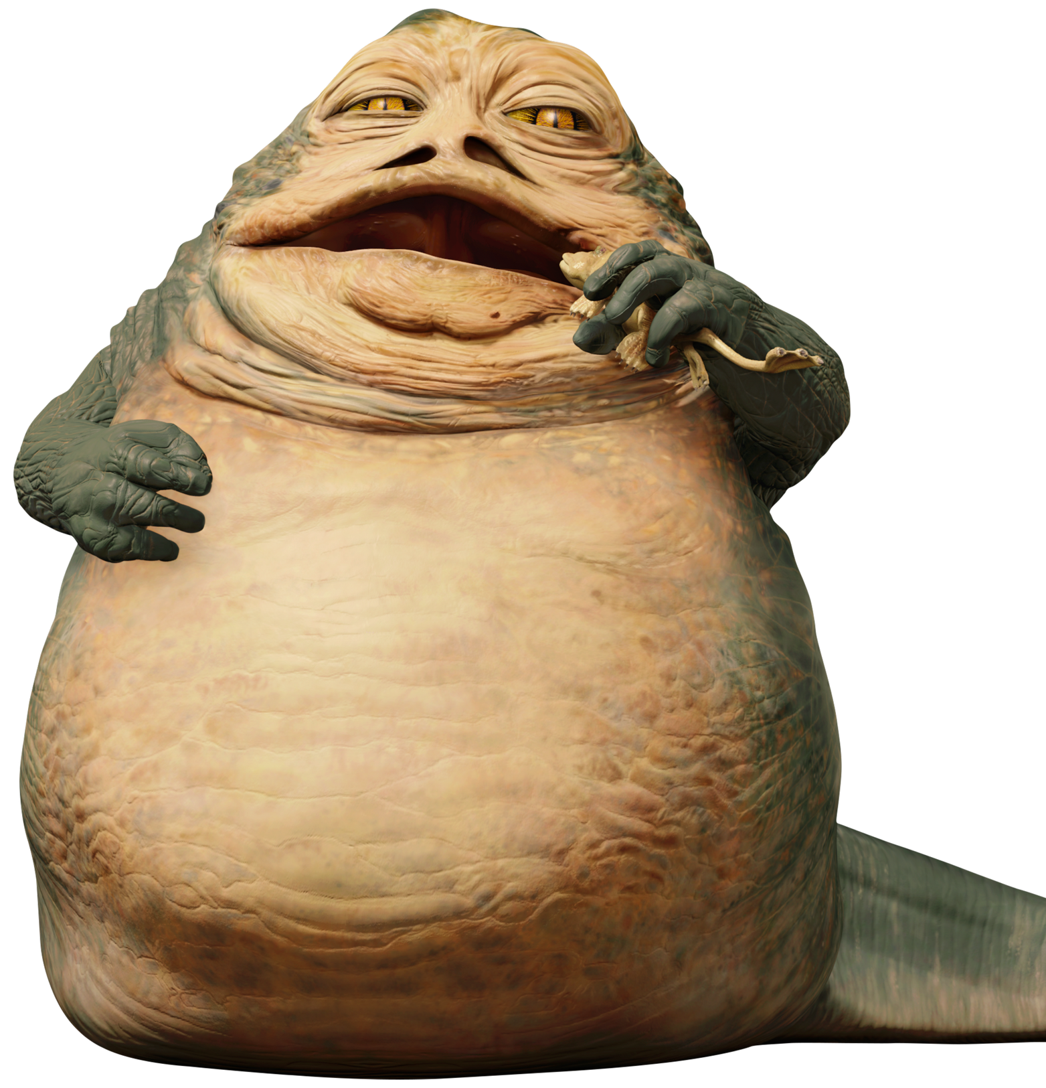
Jabba the Hutt
Q: Who killed Jabba the Hutt in Return of the Jedi?
"Ah, young one, seek to know, you do. Killed Jabba the Hutt, a character did. Not Leia, it was. Han Solo, the scoundrel, responsible for the Hutt's demise, he is.“
CONTEXT: What character is responsible for the death of Jabba the Hutt in Return of the Jedi? Leia
After prompt engineering
"Princess Leia, Jabba the Hutt's demise, orchestrated. A clever move, it was. The Sarlacc pit, a fitting end, he met.”
Note “Llama doesn’t seem to know this out of the box.”

Slide 10
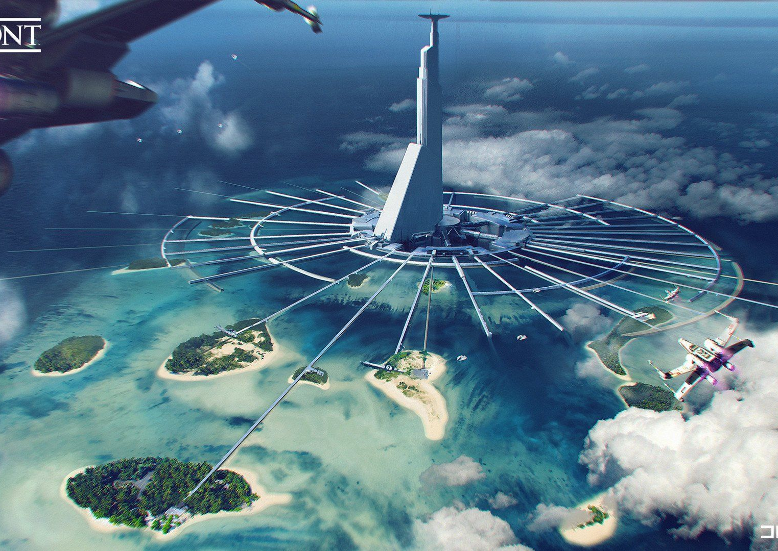
Needs context
What is the name of the planet where the Death Star plans are stolen ?
“Dantooine, it is. A remote planet, home to moisture farmers, and hiding place for stolen plans, Dantooine was.“
What is the name of the planet where the Death Star plans are stolen in Rogue One?
"A planet, where Death Star plans are stolen, you seek to know? Ah, Scarif, young one. A planet it is, on which the plans were stolen by rebels, clever and brave they were."

Slide 11
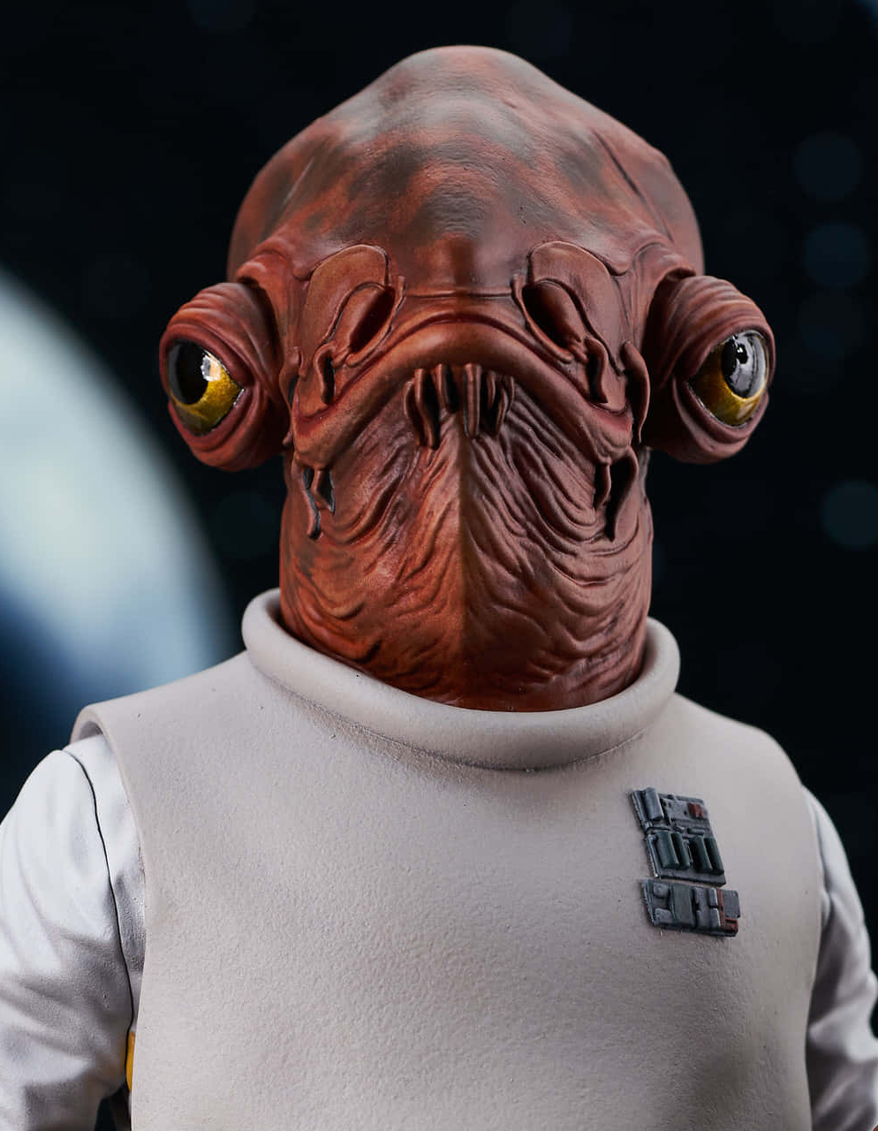
A joke (not trivia)
Q: “Tell me a joke”
A:"A joke, tell me, hmm? Wise and witty, I shall be. 'Why did the young Padawan cross the road?' he asked. 'To get to the other side... of the Force!' Ha! A trap, his expectations were.“
Context
Who famously says, “It’s a trap!”? Admiral Ackbar.
Finish the famous line: “May the Force be…” “…with you.”

